Slide 1

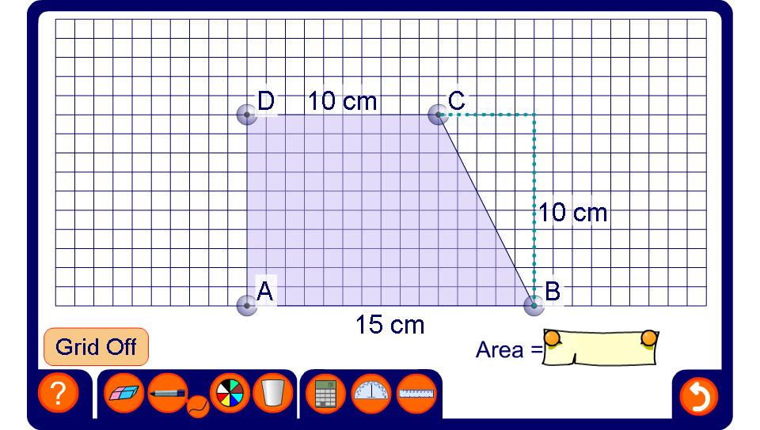


The area of a trapezium
Notes:
Modify the trapezium to change its height and the length of its parallel sides.
Use the pen tool to show how we could find the area of the trapezium by dissecting it into two triangles and a rectangle.
The square grid can be turned off once the derivation of the formula has been established.
As an extension activity discuss how we could use Pythagoras’ Theorem to calculate the perimeter of the trapezium.

